Slide 1

Team Name : Inevitables
Team Leader Name : Akshit Kotnala
Problem Statement : Simulation/Modelling of Forest Fire Spread using AI/ML techniques

Slide 2

Team Members
Team Leader: Name: Akshit Kotnala College: Army Institute of Technology Pune | Team Member-1: Name: Shivam Kapasiya College: Army Institute of Technology Pune
Team Member-2: Name: Vishal Ghosh College: Army Institute of Technology Pune | Team Member-3: Name: College:

Slide 3
Brief about the Idea:
Forest fires are growing more frequent and severe due to climate change, rising temperatures, and human encroachment. These fires threaten biodiversity, human lives, and property, and they often spread faster than authorities can respond. Most existing systems detect fires after they’ve already begun, offering little time for preventive action. To address this, our idea is to build an AI/ML-powered forest fire spread simulation model that can predict how a fire might evolve before it causes irreversible damage.
Our system will use a combination of satellite imagery, weather data (such as wind speed, humidity, and temperature), vegetation indices (like NDVI), and topographic features to forecast the likely direction, speed, and extent of a wildfire. Through spatiotemporal modeling techniques, the platform will simulate the fire’s behavior over time, helping authorities visualize its potential spread in the coming hours or days.
Users will be able to select a region or input geographic coordinates through an intuitive interface. The tool will then display an interactive map showing predicted fire zones, allowing decision-makers to prepare accordingly. This includes planning evacuations, prioritizing vulnerable zones, and efficiently deploying firefighting resources.
By combining geospatial data with machine learning and simulation, we aim to shift wildfire management from reactive to proactive. Our goal is to build a scalable, accessible system that supports real-time forecasting and better disaster response—ultimately minimizing loss to life, nature, and economy.

Slide 4
How different is it from any of the other existing ideas?
Predicts fire spread, not just detects fire.
Uses multi-source data (satellite, weather, NDVI, topography).
Provides interactive map-based simulation.
Allows custom location input for localized forecasting.
How will it be able to solve the problem?
Enables early planning and evacuation.
Supports smart deployment of firefighting resources.
Reduces damage through data-driven forecasts.
Enhances situational awareness with visual predictions.

Slide 5
USP of the proposed solution
A proactive, AI-powered wildfire simulation engine that visualizes the future path of forest fires before they ignite chaos.
Predictive simulation, not just detection.
Multi-source AI/ML modeling for higher accuracy.
User-friendly, geo-coordinate based simulation interface.
Designed for scalability—can be used in different regions with minimal setup.
Supports disaster planning and saves lives, ecosystems, and infrastructure.

Slide 6
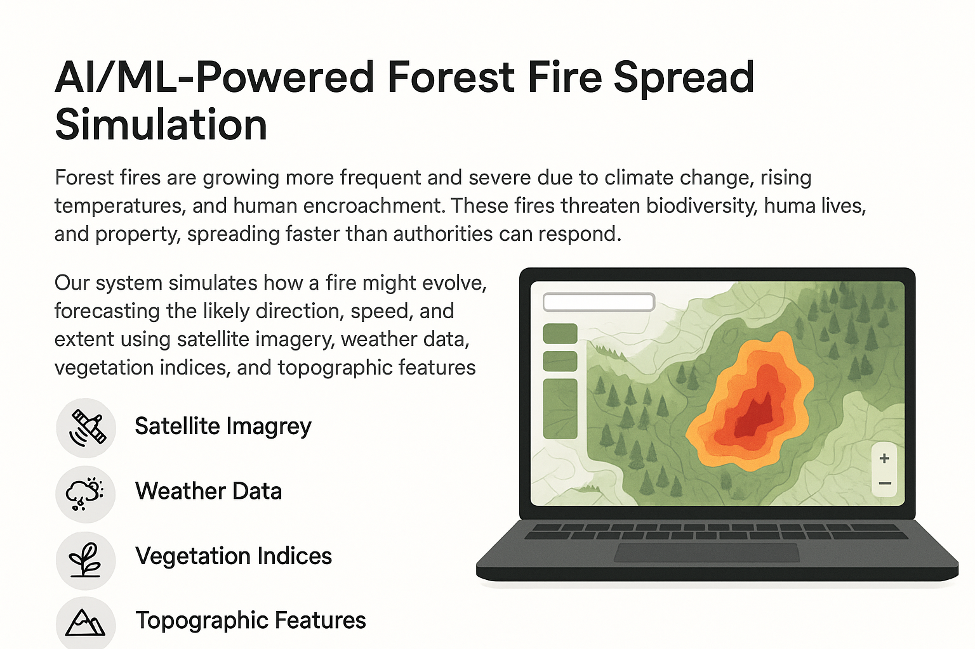
List of features offered by the solution

Slide 7
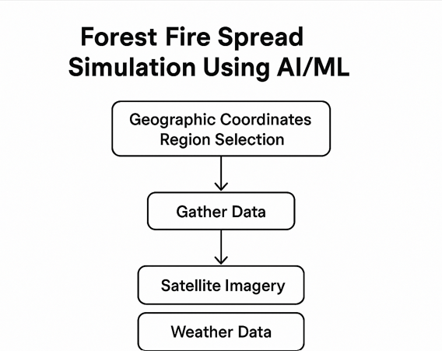
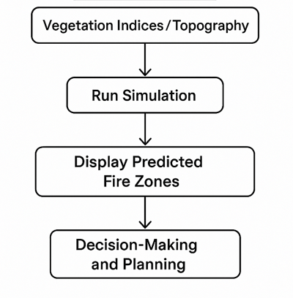
Process flow diagram Or Use-case diagram

Slide 8
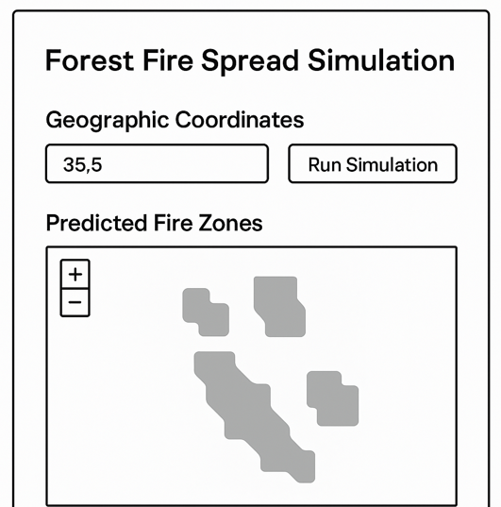

Wireframes/Mock diagrams of the proposed solution (optional)

Slide 9
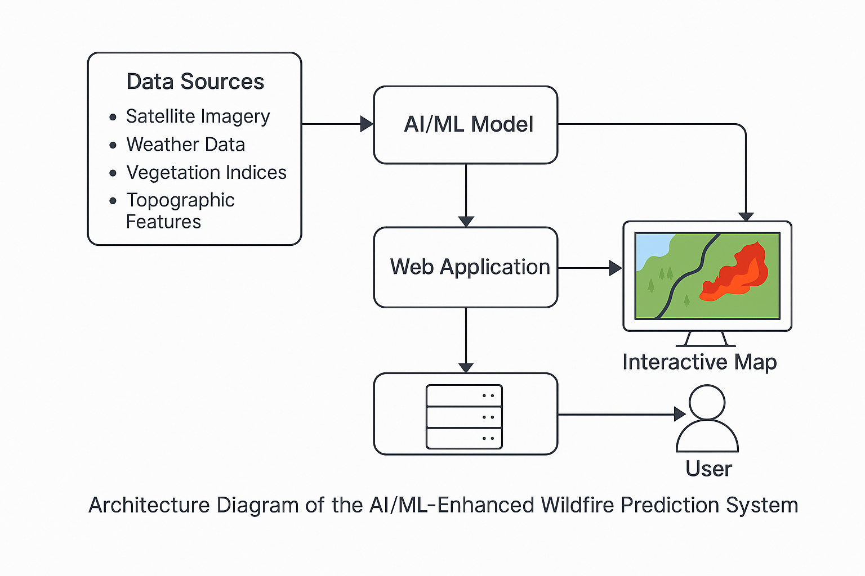
Architecture diagram of the proposed solution

Slide 10
Technologies to be used in the solution:
1 Programming & Machine Learning Frameworks
Python – Core programming language.
Scikit-learn – For traditional ML models.
TensorFlow / PyTorch – For deep learning, particularly spatiotemporal models.
2. Spatiotemporal Modeling
ConvLSTM – For capturing spatial and temporal fire spread patterns.
Temporal Fusion Transformers (TFT) – For sequence forecasting with interpretability.
Other Sequence-based ML Models – Suitable for dynamic predictions over time and space.

Slide 11
3. Satellite & Environmental Data Sources
Google Earth Engine – For accessing and processing satellite data.
MODIS, Sentinel-2, INSAT – Satellite imagery for vegetation, temperature, and fire detection.
ERA5, NASA POWER – Reanalysis weather datasets for wind speed, humidity, and temperature.
4. Geospatial Tools
GeoPandas – For geospatial vector data manipulation.
Rasterio – For reading and writing raster datasets.
QGIS – For advanced spatial data visualization and analysis.
Vegetation Indices (e.g., NDVI) – To assess fire-prone vegetation areas.

Slide 12
Estimated implementation cost (optional):
Category | Item | Estimated Cost (USD)
Data APIs | Weather & Satellite APIs (Free Tiers) | $0 – $100
Cloud Compute | Model Training (GPU on GCP/AWS) | $100 – $300
Web Hosting | App & Backend Deployment | $30 – $100
Storage | Cloud Storage for Data | $20 – $50
Visualization Tools | Mapbox / Leaflet (Free) | $0
Miscellaneous | Domain, Testing Tools | $20 – $50

Slide 13


